Slide 1

Natural Language Processing Project
Recipe Search Application
TEAM 자연어버억
MEMBERS:
20163704 박주현
20164245 홍진
20140490 이동규
20176058 박시현
20142748 이강희
20140313 양인수
Notes:
本PPT模板部分元素使用了幻灯片母版制作。如果需要修改，点击-视图-幻灯片母版-修改；完成后关闭编辑母版即可。

Slide 2
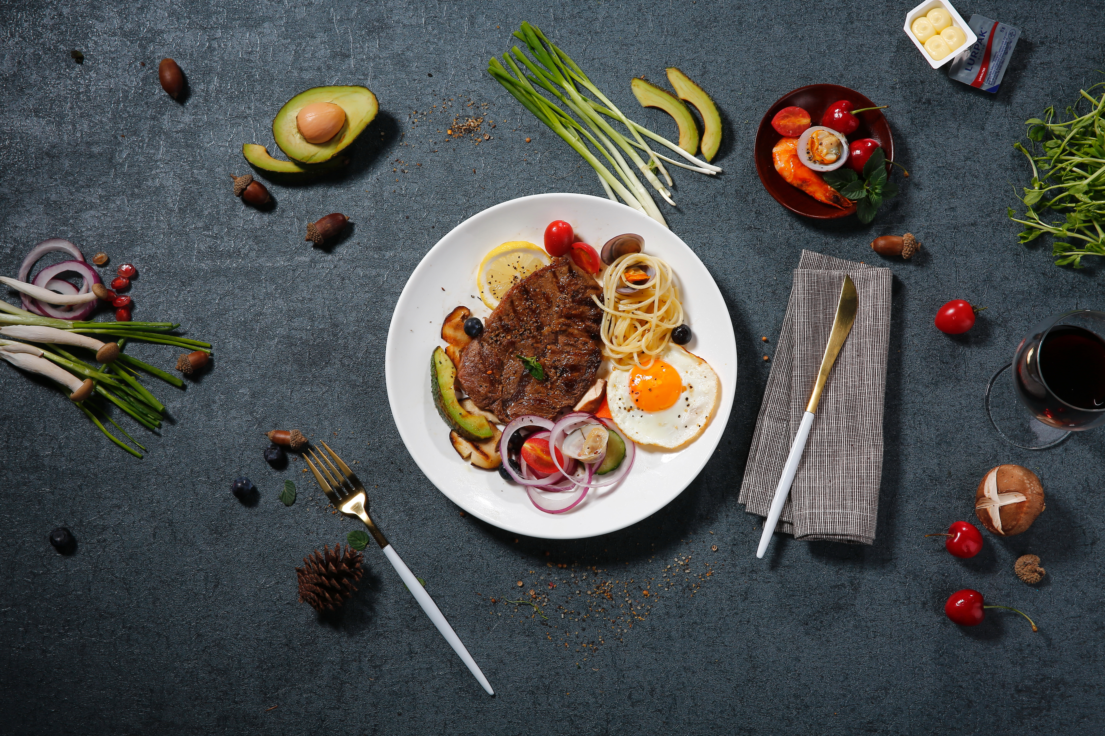
01 Introduction
CONTENTS
02 Progress
03 Schedule

Slide 3
01
Introduction
Topic Motive
Problem Deduction

Slide 4

Topic Motives
Indexed by the name of the dishes.
2. Brief descriptions of the food.
3. Mainly focuses on instructions.

Slide 5

Problem Deduction
?
Hot chicken soup with that I ate when I traveled to Korea?
Recipe books cannot understand natural language.
Without knowing the name of the dish, user needs cannot be satisfied.

Slide 6
02
Progress
Overall Design

Slide 7



Overall Design
DB
query
IR system
Ranked result

Slide 8
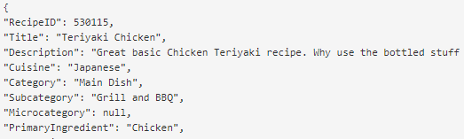

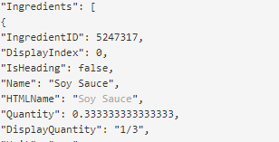

Overall Design

Slide 9

Overall Design
Data
Recipe api
Normalization
Stemming
Phrase extraction
Stopwords
DB

Slide 10

Overall Design
DB

Slide 11
Overall Design
Which Model?
Language model
BUT
OOV words!!
IR system
Word in query not exist in DB
Only similar word exist in DB

Slide 12

Overall Design
<OOV words Problem Solution>
Q1 : Hot chicken(o)
Q2 : Boiling chicken(o)
Q3 : Fire chicken(x)
Word2vec
query
Warm chicken soup from Korea?
Q1, Q2 selected
DB

Slide 13
Overall Design
Q1 : Hot chicken
Q2 : Boiling chicken
DB

Slide 14
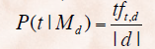
Overall Design
Q1 : Hot chicken
Q2 : Boiling chicken
D1
삼계탕
Smoothing!
OOV Word
Second Problem
Use LSA!!

Slide 15
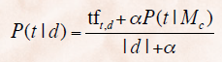
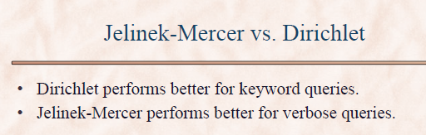
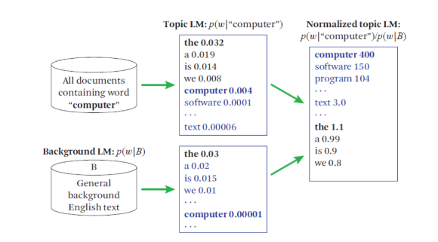
Overall Design
Use Dirichlet Smoothing for normalization
Add weight for important words like tf.idf
Evaluate precision with MAP

Slide 16
03
Schedule
Schedule

Slide 17
Schedule
WEEK 1
WEEK 2
WEEK 3
WEEK 4
01
02
03
04
WEEK 1
WEEK 2
WEEK 3
WEEK 4
Data Mining
Data Processing
Query Processing
(Machine Learning)
IR system Modeling
& Evaluation
Front Development

Slide 18
Thank You.
This is the end of our presentation.
Notes:
本PPT模板部分元素使用了幻灯片母版制作。如果需要修改，点击-视图-幻灯片母版-修改；完成后关闭编辑母版即可。

